Slide 1
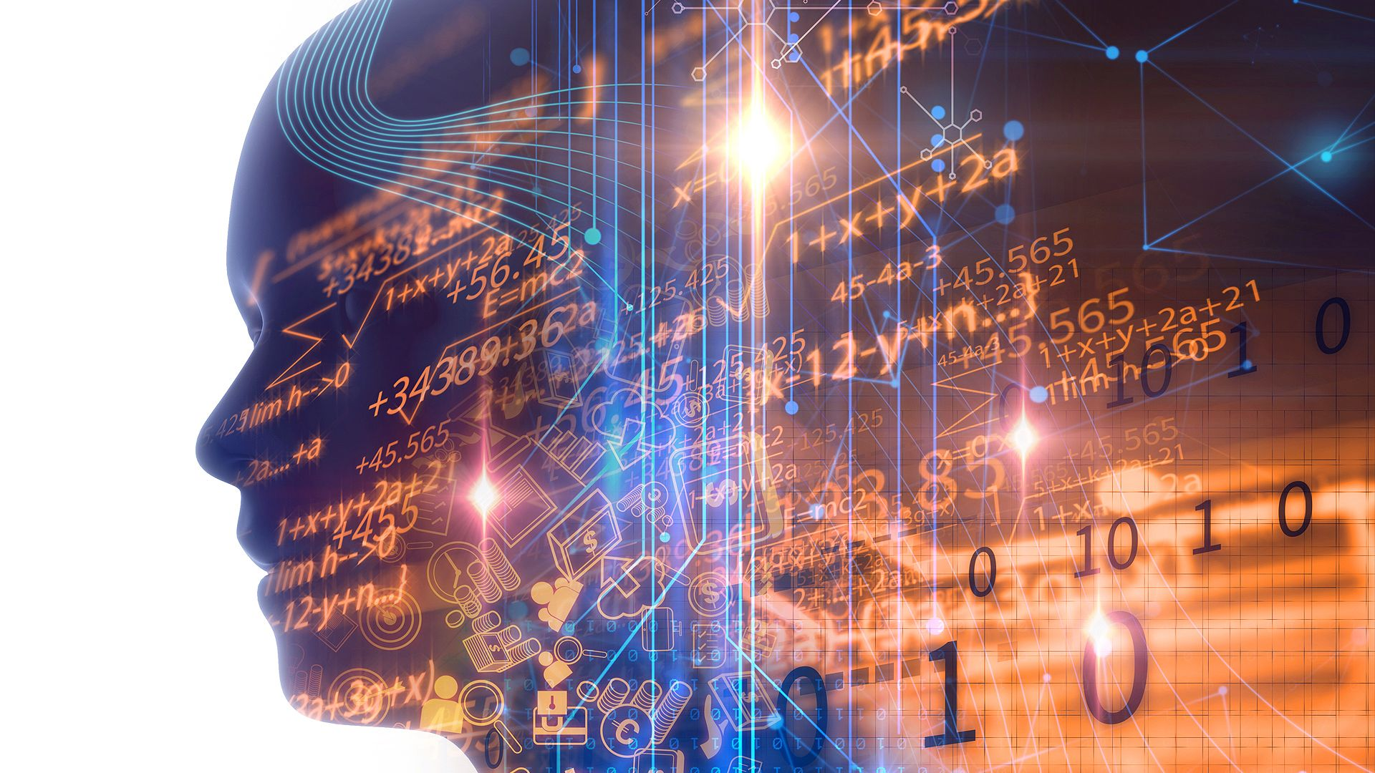
Data Analysis Project
Presented to you by: Ahmed Bahr
Welcome

Slide 2







Index
01
Part One, Introduction:
Data and Data Analysis definition and their Importance to our lives.
02
Part Two, Spot on the main steps:
Data Gatherings, Data Assessing, Data Cleaning and Visualizations Hint on the Dashboard.
03
Part Three, Data Gathering:
This slide will review some examples of codes related to data gathering’s step.
04
Part Four, Data Assessing:
This slide will review some examples of codes related to data assessing’s step.
05
Part Five, Data Cleaning:
This slide will review some examples of codes related to data cleaning’s step.
06
Part Six, Visualizations and Dashboard:
This slide will review some examples of codes and graphs related to Visualizations’ step. Also, Hint on the Dashboard.

Slide 3
Part one, Introduction:
Data and Data Analysis definition and their Importance to our lives.
1

Slide 4

What are the definitions of “Data” and “Data Analysis”?
Data Analysis | Data
> Is defined as a process of cleaning, transforming, and modeling data. Purpose: Is to extract useful information from data and taking the decision based upon the data analysis. Importance: it helps businesses to optimize their performances. | > Facts and statistics collected together for reference or analysis. – OR- is defined as facts or figures, that's stored in or used by a computer. Examples: text, observations, figures, images, numbers, graphs, or symbols.

Slide 5
Part two, Spot on the main steps:
Data Gatherings, Data Assessing, Data Cleaning and Visualizations Hint on the Dashboard.
2

Slide 6



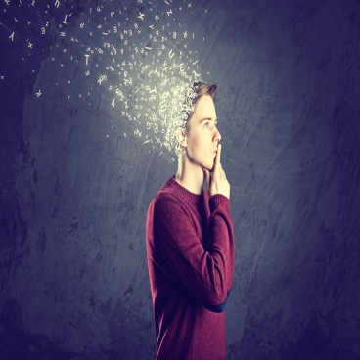
Spot on the main steps:
Data Gatherings, Assessing, Cleaning and Visualizations Hint on the Dashboard.
Definitions:
Data Collection/Gathering: Is the procedure of collecting, measuring and analyzing accurate insights for research using standard validated techniques.
Data Assessing: Is measuring particular features of the data to see if they meet defined standards
Data Cleaning: Is the process of fixing or removing incorrect, corrupted, incorrectly formatted, duplicate, or incomplete data within a dataset.
Data Visualization: Is the graphical representation of information and data
Data Dashboard: Is a tool many businesses use to track, analyze, and display data
1
Data Gathering
2
Data Assessing
3
Data Cleaning
4
Visualizations and Dashboard

Slide 7
Part Three, Data Gathering:
Review some examples of code related to data gathering’s step/process
3
Notes: - All parts related to “ Data Gathering, Assessing, Cleaning and Visualizations” will include only some examples not all the codes. - All source of codes are on the Github link.

Slide 8
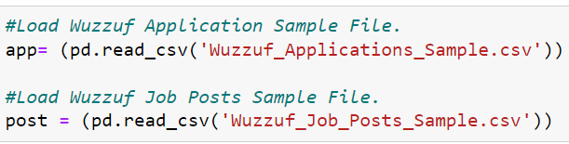
Data Gathering
Part 3
A Python library: is a collection of related modules.
- It contains bundles of code that can be used repeatedly in different programs. It makes Python Programming simpler and convenient for the programmer
- As we mentioned earlier that, the data collection process/step is: the procedure of collecting insights. But, how could we collect data by python?!
- First, by importing a python library called “Pandas”.
- As been shown above, we are going to use “read_csv” built-in function to read/call the mentioned files above with ‘csv’ file type.
Pandas: is a software library written for the Python programming language for data manipulation and analysis
The Python built-in functions: are defined as the functions whose functionality is pre-defined in Python.

Slide 9
Part Four, Data Assessing:
This slide will review some examples of code related to data assessing’s step/process.
4

Slide 10



Data Assessing
Part 4
- As we mentioned earlier that, the data assessing process/step is: measuring particular features of the data to see if they meet defined standards. But, how could we measure the data by python?!
The Jupyter Notebook: is an open source web application that you can use to create and share documents that contain live code, equations, visualizations, and text.
- By using multiple commands in “Python” including usage of pandas library too.
- As been shown above, we are going to use “value_counts( )” command to count all the values in column: ‘job_id’. “ which is located within ‘app’ variable.
- On this Example, we are going to use “info( )” command to get a full report of – what the app variable includes?- No. of Columns, Columns’ names and data-types for each.
- Here, we are going to use “sample” command to randomize and show some rows from the ‘app’ variable.
A Dataset : is a set or collection of data. This set is normally presented in a tabular pattern. Every column describes a particular variable. And each row corresponds to a given member of the data set, as per the given question. This is a part of data management.
Note: These codes are only some examples of code.

Slide 11
Part five, Data Cleaning:
This slide will review some examples of code related to data cleaning’s step/process.
5

Slide 12
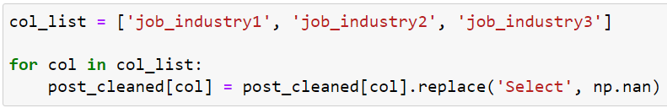
Part 5
Data Cleaning
- As we mentioned earlier that, the data cleaning process/step is: : the process of fixing or removing incorrect, corrupted, incorrectly formatted, duplicate, or incomplete data within a dataset. But, how could we clean the data by python?!
: NumPy: which stands for Numerical Python, is a library consisting of multidimensional array objects and a collection of routines for processing those arrays. Using NumPy, mathematical and logical operations on arrays can be performed.
- By using multiple commands in “Python” including usage of pandas library and Numpy library.
- As been shown below, we are going to use “to_datetime” built-in function to convert the ‘post_date’ column’s data-type to Datetime data-type. - In Co-operation with Pandas library-
- As been shown above, we are going to use an array. Then, a ‘For-Loop’ to replace each ‘Select’ value into ‘NaN’ value.
An Array: is a fundamental data structure, and an important part of most programming languages. Which, they are containers and are able to store more than one item at the same time

Slide 13
Part Six, Visualizations and Dashboard:
This slide will review some examples of code and graph related to Visualizations’ step. Also, Hint on the Dashboard
6

Slide 14

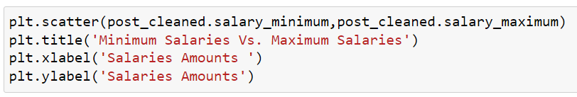
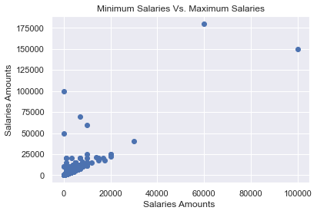
Data Visualizations and Dashboard
Part 6
- As we mentioned earlier that, the visualization process/step is: : the graphical representation of information and data. Also Dashboad, Is a tool many businesses use to track, analyze, and display data. But, how could we visualize the data by python?!
Matplotlib: is a cross-platform, data visualization and graphical plotting library for Python and its numerical extension NumPy. As such, it offers a viable open source alternative to ‘MATLAB’,
- By using multiple commands in “Python” including usage of matplotlib library and seaborn library.
Seaborn: is a Python data visualization library based on matplotlib. It provides a high-level interface for drawing attractive and informative statistical graphics
- As been shown, we are going to use “matplotlib” library to represent the relationship between ‘salary_minimum’ and ‘salary_maximum’ columns. Via, A Scatter Diagram.

Slide 15
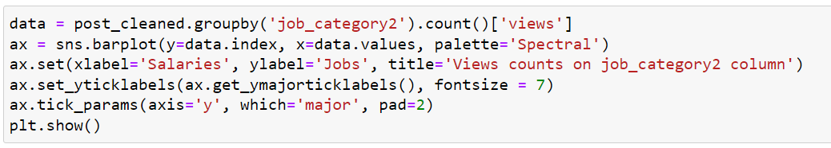
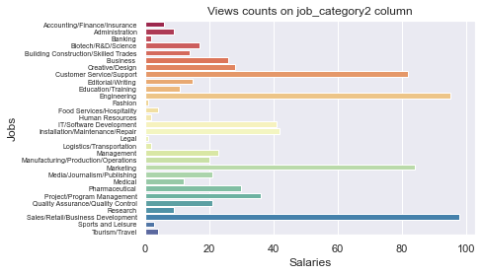
Data Visualizations and Dashboard
Part 6
- As been shown, we are going to use “seaborn” library to represent the relationship between ‘job_category2’ and ‘views’ columns. Via, Group By Bar Chart/ Horizontal Bar Chart .
A scatter diagram: is a two-dimensional graphical representation of a set of data.
A Bar Chart: can be defined as a chart or a graphical representation of data, quantities or numbers using bars or strips

Slide 16



Data Visualizations and Dashboard
Part 6
- As we mentioned earlier that, the Dashboad, Is a tool many businesses use to track, analyze, and display data. But, how could we visualize the data by python?!
- By using a dashboard in “Anaconda” Called “Voilà.
- Starting Voilà Dashboard by: pressing the button on Jupyter Notebook directly-OR-using command in Anaconda Prompt. ‘voila’
Anaconda: is an open-source distribution of the Python and R programming languages for data science that aims to simplify package management and deployment.
- We can install Voilà by using command ‘conda install voila’ in Anaconda Prompt.
- As been mentioned, we are going to use “Voilà” Dashboard to represent all the graphs. Which, has been generated by python.
Fin…

Slide 17
Thank You

